Slide 1
DAY 03 Lab 1
6.6, 6.18* & 6.20
1

Slide 2
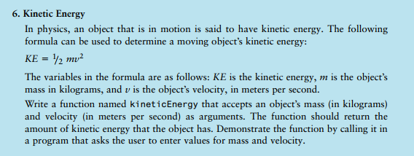

Slide 3
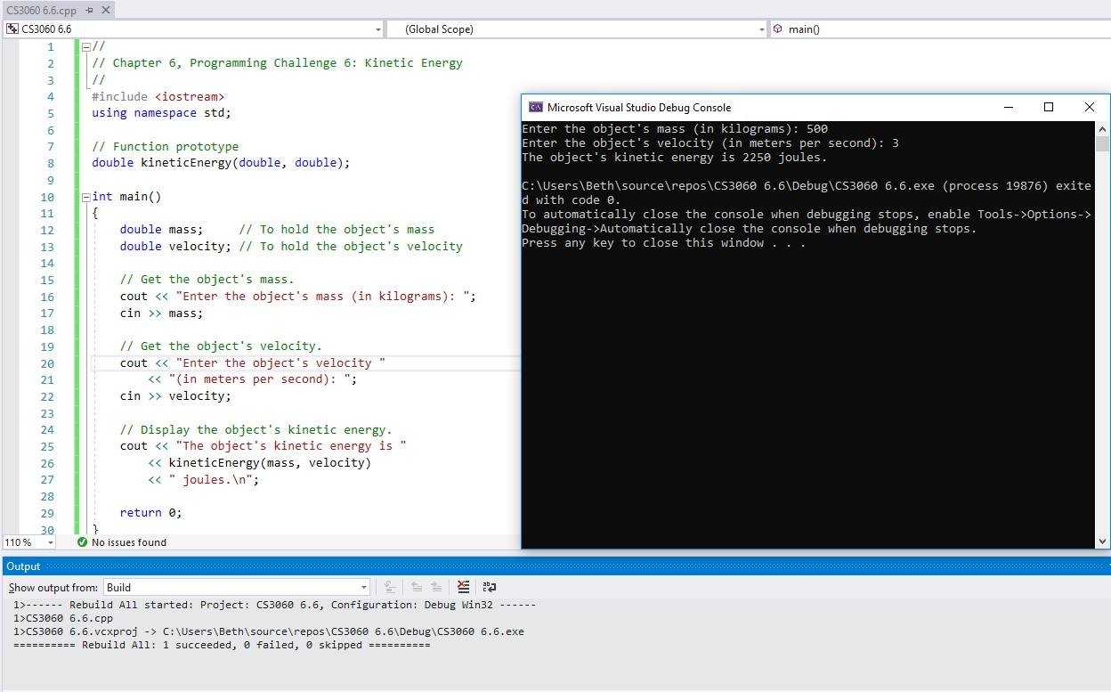

Slide 4
//
// Chapter 6, Programming Challenge 6: Kinetic Energy
//
//**********************************************
// kineticEnergy function
// This function accepts mass (in kilograms) *
// and velocity (in meters per second) and
// returns the object's kinetic energy.
*
****
*
*
int main()
{
//**********************************************
****
return 0;
}

Slide 5
//
// Chapter 6, Programming Challenge 6: Kinetic Energy
//
#include <iostream> using namespace std;
//**********************************************
// kineticEnergy function
// This function accepts mass (in kilograms) *
// and velocity (in meters per second) and
// returns the object's kinetic energy.
*
*
*
// Function prototype
//**********************************************
int main()
{
// Variables
****
// Get the object's mass.
// Get the object's velocity.
// Display the object's kinetic energy. return 0;
}

Slide 6
//
// Chapter 6, Programming Challenge 6: Kinetic Energy
//
#include <iostream> using namespace std;
//**********************************************
// kineticEnergy function
// This function accepts mass (in kilograms) *
// and velocity (in meters per second) and
// returns the object's kinetic energy.
*
*
*
// Function prototype
//**********************************************
int main()
{
// Variables
double mass; // To hold the object's mass
double velocity; // To hold the object's velocity
// Get the object's mass.
****
// Get the object's velocity.
****
// Display the object's kinetic energy.
****
return 0;
}

Slide 7
//
// Chapter 6, Programming Challenge 6: Kinetic Energy
//
#include <iostream> using namespace std;
//**********************************************
// kineticEnergy function
// This function accepts mass (in kilograms) *
// and velocity (in meters per second) and
// returns the object's kinetic energy.
*
*
*
// Function prototype
//**********************************************
****
****
int main()
{
double mass;
// To hold the object's mass
double velocity; // To hold the object's velocity
// Get the object's mass.
cout << "Enter the object's mass (in kilograms): ";
cin >> mass;
// Get the object's velocity.
cout << "Enter the object's velocity "
<< "(in meters per second): ";
cin >> velocity;
// Display the object's kinetic energy. cout << "The object's kinetic energy is "
<<
****
<< " joules.\n";
return 0;
}

Slide 8
//
// Chapter 6, Programming Challenge 6: Kinetic Energy
//
#include <iostream> using namespace std;
//**********************************************
// kineticEnergy function
// This function accepts mass (in kilograms) *
// and velocity (in meters per second) and
// returns the object's kinetic energy.
*
*
*
// Function prototype
double kineticEnergy(double, double);
//**********************************************
double kineticEnergy(double mass, double velocity)
{
return 0.5 * mass * velocity * velocity;
}
int main()
{
double mass;
// To hold the object's mass
double velocity; // To hold the object's velocity
// Get the object's mass.
cout << "Enter the object's mass (in kilograms): ";
cin >> mass;
// Get the object's velocity.
cout << "Enter the object's velocity "
<< "(in meters per second): ";
cin >> velocity;
// Display the object's kinetic energy. cout << "The object's kinetic energy is "
<< kineticEnergy(mass, velocity)
<< " joules.\n";
return 0;
}

Slide 9
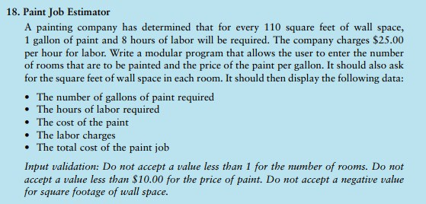

Slide 10
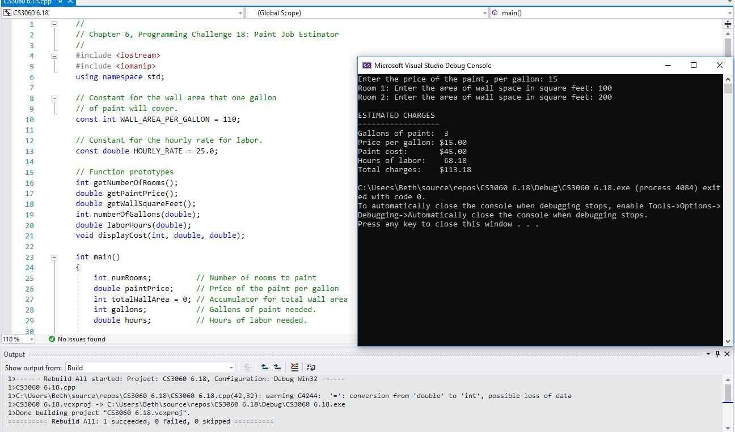

Slide 11
//
// Chapter 6, Programming Challenge 18: Paint Job Estimator
//
int main()
{
// Variables
****
****
// Constants for the wall area that one gallon
// of paint will cover.
return 0;
}
****
// Constant for the hourly rate for labor.
****
// Function prototypes

Slide 12
Enumerated Constants
Not doing this now but remember when using named spaces
Enumerated constants create a set of constants with a single statement.
They are defined with the keyword enum followed by a series of comma- separated names surrounded by braces:
enum CAR_TYPE { TESLA, FORD, CHEVY, BMW, MERCEDES_BENZ};

Slide 13
//
// Chapter 6, Programming Challenge 18: Paint Job Estimator
//
#include <iostream> #include <iomanip>
using namespace std;
int main()
{
// Variables
// Number of rooms to paint
// Price of the paint per gallon
// Accumulator for total wall area
// Gallons of paint needed.
// Hours of labor needed.
// If we don’t want to use this line of code,
// we can use the things in this namespace like
// this. std::cout, std::endl.
// Get the number of rooms.
// Get the price of the paint per gallon.
// Constant for the wall area that one gallon
// of paint will cover.
const int WALL_AREA_PER_GALLON = 110;
// Get the total wall area of the rooms.
// Get the number of gallons of paint needed.
// Constant for the hourly rate for labor. const double HOURLY_RATE = 25.0;
// Get the number of labor hours needed.
// Function prototypes
// Display the total charges.
****
return 0;
}

Slide 14
Parameters, Prototypes, and Function Headers
For each function argument,
the prototype must include the data type of each parameter inside its parentheses
the header must include a declaration for each parameter in its ()
void evenOrOdd(int); //prototype
void evenOrOdd(int num) //header
evenOrOdd(val); //call

Slide 15
//
// Chapter 6, Programming Challenge 18: Paint Job Estimator
//
#include <iostream> #include <iomanip>
using namespace std;
int main()
{
// Variables
// Number of rooms to paint
// Price of the paint per gallon
// Accumulator for total wall area
// Gallons of paint needed.
// Hours of labor needed.
// If we don’t want to use this line of code,
// we can use the things in this namespace like
// this. std::cout, std::endl.
// Get the number of rooms.
// Get the price of the paint per gallon.
// Constant for the wall area that one gallon
// of paint will cover.
const int WALL_AREA_PER_GALLON = 110;
// Get the total wall area of the rooms.
// Get the number of gallons of paint needed.
// Constant for the hourly rate for labor. const double HOURLY_RATE = 25.0;
// Get the number of labor hours needed.
// Function prototypes int getNumberOfRooms(); double getPaintPrice();
double getWallSquareFeet();
int numberOfGallons(double); double laborHours(double);
void displayCost(int, double, double);
// Display the total charges.
return 0;
}

Slide 16
//
// Chapter 6, Programming Challenge 18: Paint Job Estimator
//
#include <iostream> #include <iomanip> using namespace std;
int main()
{
// Variables
// Number of rooms to paint
// Price of the paint per gallon
// Accumulator for total wall area
// Gallons of paint needed.
// Hours of labor needed.
****
****
****
****
****
// If we don’t want to use this line of code,
// we can use the things in this namespace like
// this. std::cout, std::endl.
// Get the number of rooms.
// Constant for the wall area that one gallon
// of paint will cover.
const int WALL_AREA_PER_GALLON = 110;
// Get the price of the paint per gallon.
// Get the total wall area of the rooms.
// Constant for the hourly rate for labor. const double HOURLY_RATE = 25.0;
// Get the number of gallons of paint needed.
// Get the number of labor hours needed.
// Function prototypes int getNumberOfRooms(); double getPaintPrice();
double getWallSquareFeet(); int numberOfGallons(double); double laborHours(double);
void displayCost(int, double, double);
// Display the total charges.
return 0;
}

Slide 17
//
// Chapter 6, Programming Challenge 18: Paint Job Estimator
//
#include <iostream> #include <iomanip> using namespace std;
int main()
{
// Variables
// Number of rooms to paint
int numRooms;
double paintPrice; // Price of the paint per gallon
int totalWallArea = 0; // Accumulator for total wall area
int gallons; double hours;
// Gallons of paint needed.
// Hours of labor needed.
// Constant for the wall area that one gallon
// of paint will cover.
const int WALL_AREA_PER_GALLON = 110;
// Get the number of rooms.
****
// Constant for the hourly rate for labor. const double HOURLY_RATE = 25.0;
// Get the price of the paint per gallon.
****
// Function prototypes int getNumberOfRooms(); double getPaintPrice();
double getWallSquareFeet();
int numberOfGallons(double); double laborHours(double);
void displayCost(int, double, double);
// Get the total wall area of the rooms.
****
// Get the number of gallons of paint needed.
// Get the number of labor hours needed.
// Display the total charges.
return 0;
}

Slide 18
//
// Chapter 6, Programming Challenge 18: Paint Job Estimator
//
#include <iostream> #include <iomanip>
using namespace std;
int main()
{
// Variables
int numRooms;
// Number of rooms to paint
// Price of the paint per gallon
double paintPrice;
int totalWallArea = 0; // Accumulator for total wall area
int gallons; double hours;
// Gallons of paint needed.
// Hours of labor needed.
// Constant for the wall area that one gallon
// of paint will cover.
const int WALL_AREA_PER_GALLON = 110;
// Get the number of rooms. numRooms = getNumberOfRooms();
// Constant for the hourly rate for labor. const double HOURLY_RATE = 25.0;
// Get the price of the paint per gallon. paintPrice = getPaintPrice();
// Function prototypes int getNumberOfRooms(); double getPaintPrice();
double getWallSquareFeet(); int numberOfGallons(double); double laborHours(double);
void displayCost(int, double, double);
// Get the total wall area of the rooms. for (int i = 1; i <= numRooms; i++)
{
int wallArea;
cout << "Room " << i << ": "; wallArea = getWallSquareFeet();
totalWallArea += wallArea;
}
// Get the number of gallons of paint needed.
****
// Get the number of labor hours needed.
****
// Display the total charges.
****
return 0;
}

Slide 19
//
// Chapter 6, Programming Challenge 18: Paint Job Estimator
//
#include <iostream> #include <iomanip>
using namespace std;
int main()
{
// Variables
int numRooms;
// Number of rooms to paint
// Price of the paint per gallon
double paintPrice;
int totalWallArea = 0; // Accumulator for total wall area
int gallons; double hours;
// Gallons of paint needed.
// Hours of labor needed.
// Constant for the wall area that one gallon
// of paint will cover.
const int WALL_AREA_PER_GALLON = 110;
// Get the number of rooms. numRooms = getNumberOfRooms();
// Constant for the hourly rate for labor. const double HOURLY_RATE = 25.0;
// Get the price of the paint per gallon. paintPrice = getPaintPrice();
// Function prototypes int getNumberOfRooms(); double getPaintPrice();
double getWallSquareFeet(); int numberOfGallons(double); double laborHours(double);
void displayCost(int, double, double);
// Get the total wall area of the rooms. for (int i = 1; i <= numRooms; i++)
{
int wallArea;
cout << "Room " << i << ": "; wallArea = getWallSquareFeet();
totalWallArea += wallArea;
}
// Get the number of gallons of paint needed. gallons = numberOfGallons(totalWallArea);
// Get the number of labor hours needed. hours = laborHours(totalWallArea);
// Display the total charges. displayCost(gallons, paintPrice, hours);
return 0;
}

Slide 20
// ********************************************************
// The getNumberOfRooms function asks the user to enter *
// ********************************************************
// the number of rooms that are to be painted. The number *
// The getPaintPrice function asks the user to enter the *
// price of the paint per gallon. The price is returned *
// of rooms is returned as an integer. *
// ********************************************************
// as a double. *
int getNumberOfRooms()
{
// ********************************************************
double getPaintPrice()
{
****
return rooms;
}
****
return price;
}

Slide 21
// ********************************************************
// ********************************************************
// The getNumberOfRooms function asks the user to enter *
// The getPaintPrice function asks the user to enter the *
// price of the paint per gallon. The price is returned *
// as a double. *
// the number of rooms that are to be painted. The number *
// of rooms is returned as an integer. *
// ********************************************************
// ********************************************************
int getNumberOfRooms()
{
int rooms;
double getPaintPrice()
{
double price;
// Get the number of rooms.
// Get the price per gallon.
****
****
// Validate the input.
// Validate the input.
return rooms;
}
return price;
}

Slide 22
// ********************************************************
// ********************************************************
// The getNumberOfRooms function asks the user to enter *
// The getPaintPrice function asks the user to enter the *
// price of the paint per gallon. The price is returned *
// the number of rooms that are to be painted. The number *
// of rooms is returned as an integer. *
// as a double. *
// ********************************************************
// ********************************************************
int getNumberOfRooms()
{
int rooms;
double getPaintPrice()
{
double price;
// Get the number of rooms.
cout << "Enter the number of rooms to be painted: "; cin >> rooms;
// Get the price per gallon.
cout << "Enter the price of the paint, per gallon: "; cin >> price;
// Validate the input. while (rooms < 1)
{
cout << "ERROR: Enter 1 or greater.\n";
cout << "Enter the number of rooms to be painted: "; cin >> rooms;
}
// Validate the input. while (price < 10.0)
{
cout << "ERROR: Paint price must be 10.00 or greater.\n";
cout << "Enter the price of the paint, per gallon: "; cin >> price;
}
return rooms;
}
return price;
}

Slide 23
// ********************************************************
// ********************************************************
// The getWallSquareFeet function asks the user to enter *
// the square feet of wall space for a room. The number *
// The numberOfGallons function accepts as an argument *
// the total square feet of wall space and calculates the *
// of square feet is returned as a double. *
// number of gallons of paint required. The number of
// gallons is returned as an integer.
*
*
// ********************************************************
// ********************************************************
double getWallSquareFeet()
{
int numberOfGallons(double wallArea)
{
// Variables
****
return wallArea;
}
****
return intGallons;
}

Slide 24
// ********************************************************
// ********************************************************
// The getWallSquareFeet function asks the user to enter *
// the square feet of wall space for a room. The number *
// The numberOfGallons function accepts as an argument *
// the total square feet of wall space and calculates the *
// of square feet is returned as a double. *
// number of gallons of paint required. The number of
// gallons is returned as an integer.
*
*
// ********************************************************
// ********************************************************
double getWallSquareFeet()
{
double wallArea;
int numberOfGallons(double wallArea)
{
// Variables
// Get the wall space area.
****
****
// Calculate the gallons as a double.
// Validate the input.
// Get the truncated number of gallons.
return wallArea;
}
// Get the fractional part of a gallon needed.
// Determine if a fractional part of a gallon is needed.
return intGallons;
}

Slide 25
// ********************************************************
// ********************************************************
// The getWallSquareFeet function asks the user to enter *
// the square feet of wall space for a room. The number *
// The numberOfGallons function accepts as an argument *
// of square feet is returned as a double. *
// the total square feet of wall space and calculates the *
// ********************************************************
// number of gallons of paint required. The number of
// gallons is returned as an integer.
*
*
double getWallSquareFeet()
{
double wallArea;
// ********************************************************
int numberOfGallons(double wallArea)
{
// Variables
double doubleGallons; double remainder;
int intGallons;
// Get the wall space area.
cout << "Enter the area of wall space in square feet: "; cin >> wallArea;
// Validate the input.
// Calculate the gallons as a double.
****
****
return wallArea;
}
// Get the truncated number of gallons.
****
// Get the fractional part of a gallon needed.
****
// Determine if a fractional part of a gallon is needed.
****
return intGallons;
}

Slide 26
// ********************************************************
// ********************************************************
// The getWallSquareFeet function asks the user to enter *
// the square feet of wall space for a room. The number *
// The numberOfGallons function accepts as an argument *
// of square feet is returned as a double. *
// the total square feet of wall space and calculates the *
// ********************************************************
// number of gallons of paint required. The number of
// gallons is returned as an integer.
*
*
double getWallSquareFeet()
{
double wallArea;
// ********************************************************
int numberOfGallons(double wallArea)
{
double doubleGallons;
double remainder; int intGallons;
// Get the wall space area.
cout << "Enter the area of wall space in square feet: "; cin >> wallArea;
// Validate the input. while (wallArea < 0)
{
cout << "ERROR: Wall area must be a non-negative number.\n";
cout << "Enter the area of wall space in square feet: "; cin >> wallArea;
}
// Calculate the gallons as a double. doubleGallons = wallArea / WALL_AREA_PER_GALLON;
// Get the truncated number of gallons. intGallons = static_cast<int>(doubleGallons);
// Get the fractional part of a gallon needed.
remainder = doubleGallons - static_cast<int>(doubleGallons);
return wallArea;
}
// Determine if a fractional part of a gallon is needed. if (remainder > 0)
intGallons += 1; // If so, add 1 gallon.
return intGallons;
}

Slide 27
// ********************************************************
// ********************************************************
// The laborHours function accepts as an argument the
// total square feet of wall space and calculates the
// hours of labor needed to paint that amount of wall
// space. The number of hours is returned as a double.
*
*
*
*
// The displayCost function accepts as arguments the *
// number of gallons of paint, the price per gallon, and *
// the number of labor hours required for the job. It *
// calculates and displays the total estimated charges. *
// ********************************************************
// ********************************************************
double laborHours(double wallArea)
{
void displayCost(int gallons, double paintPrice, double hours)
{
// Variables
****
}
****
}

Slide 28
// ********************************************************
// The laborHours function accepts as an argument the
// total square feet of wall space and calculates the
// hours of labor needed to paint that amount of wall
// space. The number of hours is returned as a double.
*
*
*
*
// ********************************************************
// The displayCost function accepts as arguments the *
// number of gallons of paint, the price per gallon, and *
// the number of labor hours required for the job. It *
// calculates and displays the total estimated charges. *
// ********************************************************
// ********************************************************
double laborHours(double wallArea)
{
// 1 hour of labor is required for every
// 115 square feet of wall space.
void displayCost(int gallons, double paintPrice, double hours)
{
// Variables
****
****
// To hold the total cost of the paint.
// To hold the total labor charges.
// To hold the total cost of the job.
****
return hours;
}
****
// Calculate the total cost of the paint.
// Calculate the total labor charges.
// Calculate the total cost of the job.
// Display the charges for the job.
}

Slide 29
// ********************************************************
// ********************************************************
// The laborHours function accepts as an argument the
// total square feet of wall space and calculates the
// hours of labor needed to paint that amount of wall
// space. The number of hours is returned as a double.
*
*
*
*
// The displayCost function accepts as arguments the *
// number of gallons of paint, the price per gallon, and *
// the number of labor hours required for the job. It *
// calculates and displays the total estimated charges. *
// ********************************************************
// ********************************************************
double laborHours(double wallArea)
{
// 1 hour of labor is required for every
// 115 square feet of wall space.
double hours = wallArea / WALL_AREA_PER_GALLON;
void displayCost(int gallons, double paintPrice, double hours)
{
double totalPaintCost; // To hold the total cost of the paint.
double totalLabor;// To hold the total labor charges. double totalCharges;// To hold the total cost of the job.
return hours;
}
// Calculate the total cost of the paint.
****
// Calculate the total labor charges.
****
// Calculate the total cost of the job.
****
// Display the charges for the job.
****
}

Slide 30
// ********************************************************
// ********************************************************
// The laborHours function accepts as an argument the
// total square feet of wall space and calculates the
// hours of labor needed to paint that amount of wall
// space. The number of hours is returned as a double.
*
*
*
*
// The displayCost function accepts as arguments the *
// number of gallons of paint, the price per gallon, and *
// the number of labor hours required for the job. It *
// ********************************************************
// calculates and displays the total estimated charges. *
// ********************************************************
double laborHours(double wallArea)
{
// 1 hour of labor is required for every
// 115 square feet of wall space.
double hours = wallArea / WALL_AREA_PER_GALLON;
void displayCost(int gallons, double paintPrice, double hours)
{
double totalPaintCost; // To hold the total cost of the paint.
double totalLabor;// To hold the total labor charges.
double totalCharges;// To hold the total cost of the job.
return hours;
}
// Calculate the total cost of the paint. totalPaintCost = gallons * paintPrice;
// Calculate the total labor charges. totalLabor = hours * HOURLY_RATE;
// Calculate the total cost of the job. totalCharges = totalPaintCost + totalLabor;
// Display the charges for the job.
cout << fixed << showpoint << setprecision(2); cout << "\nESTIMATED CHARGES\n";
cout << "
\n";
cout << "Gallons of paint: " << gallons << endl;
cout << "Price per gallon: $" << paintPrice << endl;
cout << "Paint cost: cout << "Hours of labor: cout << "Total charges:
}
$" << totalPaintCost << endl;
" << totalLabor << endl;
$" << totalCharges << endl;

Slide 31
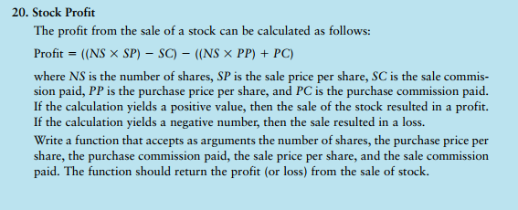

Slide 32
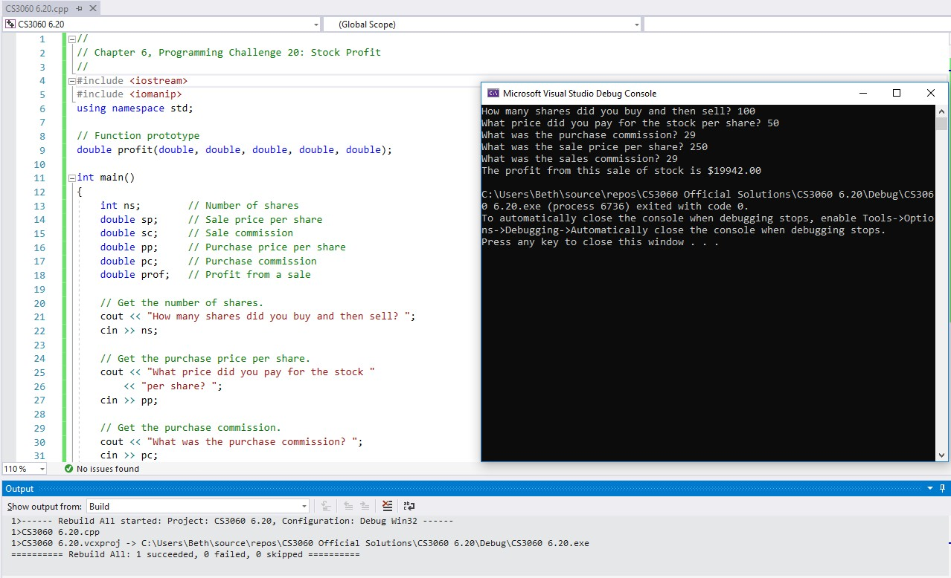

Slide 33
// Chapter 6, Programming Challenge 20: Stock Profit
// ********************************************************
// The profit function accepts as arguments the number of *
****
// shares, the purchase price per share, the purchase *
// commission paid, the sale price per share, and the *
// sale commission paid. The function returns the profit *
// (or loss) from the sale of stock as a double. *
int main()
{
// Variables
// ********************************************************
****
return 0;
}

Slide 34
// Chapter 6, Programming Challenge 20: Stock Profit
// Get the sale price per share.
// Get the sales commission.
#include <iostream> #include <iomanip> using namespace std;
// Get the profit or loss.
// Display the result.
// Function prototype
return 0;
}
int main()
{
// Variables
// ********************************************************
****
****
****
****
****
****
 |  | // Number of shares // The profit function accepts as arguments the number of * // Sale price per share // shares, the purchase price per share, the purchase * // Sale commission // commission paid, the sale price per share, and the * // Purchase price per share // sale commission paid. The function returns the profit * // Purchase commission // (or loss) from the sale of stock as a double. *
 |  | // Profit from a sale | // | ********************************************************
// // // | Get Get Get | the number of shares. the purchase price per share. the purchase commission.

Slide 35
// Chapter 6, Programming Challenge 20: Stock Profit
// Get the sale price per share.
****
#include <iostream> #include <iomanip> using namespace std;
// Get the sales commission.
****
// Get the profit or loss.
// Function prototype
****
int main()
{
int ns;
// Display the result.
****
// Number of shares
return 0;
double | sp; // | Sale price per share | }
double double | sc; // pp; // | Sale commission Purchase price per share | // | ********************************************************
double | pc; // | Purchase commission | // | The profit function accepts as arguments the number of *
double | prof; // | Profit from a sale | // // | shares, the purchase price per share, the purchase * commission paid, the sale price per share, and the *
// Get | the number | of shares. | // | sale commission paid. The function returns the profit *
**** |  |  | // | (or loss) from the sale of stock as a double. *
 |  |  | // | ********************************************************
// Get **** | the purchase price per share. |  | ****
// Get the purchase commission.
****

Slide 36
// Chapter 6, Programming Challenge 20: Stock Profit
// Get the sale price per share.
cout << "What was the sale price per share? "; cin >> sp;
#include <iostream> #include <iomanip> using namespace std;
// Get the sales commission.
cout << "What was the sales commission? ";
cin >> sc;
// Function prototype
****
// Get the profit or loss.
int main()
{
int ns; double sp; double sc; double pp; double pc; double prof;
prof =
****
// Number of shares
// Sale price per share
// Sale commission
// Purchase price per share
// Purchase commission
// Profit from a sale
// Display the result.
cout << "The profit from this sale of stock is $"
<< setprecision(2) << fixed << showpoint
<< prof << endl;
return 0;
}
// Get the number of shares.
cout << "How many shares did you buy and then sell? "; cin >> ns;
// ********************************************************
// The profit function accepts as arguments the number of *
// shares, the purchase price per share, the purchase *
// commission paid, the sale price per share, and the *
// sale commission paid. The function returns the profit *
// (or loss) from the sale of stock as a double. *
// Get the purchase price per share.
cout << "What price did you pay for the stock "
<< "per share? "; cin >> pp;
// ********************************************************
// Get the purchase commission.
cout << "What was the purchase commission? "; cin >> pc;
****

Slide 37
Function Prototypes
Ways to notify the compiler about a function before a call to the function:
Place function definition before calling function’s definition
Use a function prototype (function declaration) – like the function definition without the body
Header: void printHeading()
Prototype: void printHeading();
37

Slide 38
// Chapter 6, Programming Challenge 20: Stock Profit
// Get the sale price per share.
cout << "What was the sale price per share? "; cin >> sp;
#include <iostream> #include <iomanip> using namespace std;
// Get the sales commission.
cout << "What was the sales commission? ";
cin >> sc;
// Function prototype
double profit(double, double, double, double, double);
// Get the profit or loss.
prof = profit(ns, pp, pc, sp, sc);
int main()
{
int ns; double sp; double sc; double pp; double pc; double prof;
// Number of shares
// Sale price per share
// Sale commission
// Purchase price per share
// Purchase commission
// Profit from a sale
// Display the result.
cout << "The profit from this sale of stock is $"
<< setprecision(2) << fixed << showpoint
<< prof << endl;
return 0;
}
// Get the number of shares.
cout << "How many shares did you buy and then sell? "; cin >> ns;
// ********************************************************
// The profit function accepts as arguments the number of *
// shares, the purchase price per share, the purchase *
// commission paid, the sale price per share, and the *
// sale commission paid. The function returns the profit *
// (or loss) from the sale of stock as a double. *
// Get the purchase price per share.
cout << "What price did you pay for the stock "
<< "per share? "; cin >> pp;
// ********************************************************
// Get the purchase commission.
cout << "What was the purchase commission? "; cin >> pc;
****

Slide 39

// Get the sale price per share.
cout << "What was the sale price per share? "; cin >> sp;
// Chapter 6, Programming Challenge 20: Stock Profit
#include <iostream> #include <iomanip> using namespace std;
// Get the sales commission.
cout << "What was the sales commission? ";
cin >> sc;
// Function prototype
double profit(double, double, double, double, double);
// Get the profit or loss.
prof = profit(ns, pp, pc, sp, sc);
int main()
{
int ns; double sp; double sc; double pp; double pc; double prof;
// Display the result.
cout << "The profit from this sale of stock is $"
<< setprecision(2) << fixed << showpoint
<< prof << endl;
// Number of shares
// Sale price per share
// Sale commission
// Purchase price per share
// Purchase commission
// Profit from a sale
return 0;
}
// Get the number of shares.
cout << "How many shares did you buy and then sell? ";
cin >> ns;
// ********************************************************
// The profit function accepts as arguments the number of *
// shares, the purchase price per share, the purchase *
// commission paid, the sale price per share, and the *
// sale commission paid. The function returns the profit *
// Get the purchase price per share.
cout << "What price did you pay for the stock "
<< "per share? "; cin >> pp;
// (or loss) from the sale of stock as a double. *
// ********************************************************
double profit(double ns, double pp, double pc, double sp, double sc)
{
// Get the purchase commission.
cout << "What was the purchase commission? ";
cin >> pc;
****
}

Slide 40
// Get the sale price per share.
cout << "What was the sale price per share? "; cin >> sp;
// Chapter 6, Programming Challenge 20: Stock Profit
#include <iostream> #include <iomanip> using namespace std;
// Get the sales commission.
cout << "What was the sales commission? ";
cin >> sc;
// Function prototype
double profit(double, double, double, double, double);
// Get the profit or loss.
prof = profit(ns, pp, pc, sp, sc);
int main()
{
int ns; double sp; double sc; double pp; double pc; double prof;
// Display the result.
cout << "The profit from this sale of stock is $"
<< setprecision(2) << fixed << showpoint
<< prof << endl;
// Number of shares
// Sale price per share
// Sale commission
// Purchase price per share
// Purchase commission
// Profit from a sale
return 0;
}
// Get the number of shares.
cout << "How many shares did you buy and then sell? ";
cin >> ns;
// ********************************************************
// The profit function accepts as arguments the number of *
// shares, the purchase price per share, the purchase *
// commission paid, the sale price per share, and the *
// sale commission paid. The function returns the profit *
// Get the purchase price per share.
cout << "What price did you pay for the stock "
<< "per share? "; cin >> pp;
// (or loss) from the sale of stock as a double. *
// ********************************************************
double profit(double ns, double pp, double pc, double sp, double sc)
{
return ((ns * sp) - sc) - ((ns * pp) + pc);
// Get the purchase commission.
cout << "What was the purchase commission? ";
cin >> pc;
}

